Slide 1

Exploring the Impact of ESG Reporting on Investment Risk in Hong Kong
PROJECT TEAM MEMBERS :
LAM MARCO WALLY (7)
WONG SAU WAI SOPHIA (10)
CHOW HO NAM (25)
LEUNG HANG YEE (2)
YIP LAI YUK, YOYO (21)

Slide 2

Contents:
Introduction
Objectives
Hypothesis and Methodology
Data Collections
Data Analysis and Discussion
Conclusion

Slide 3
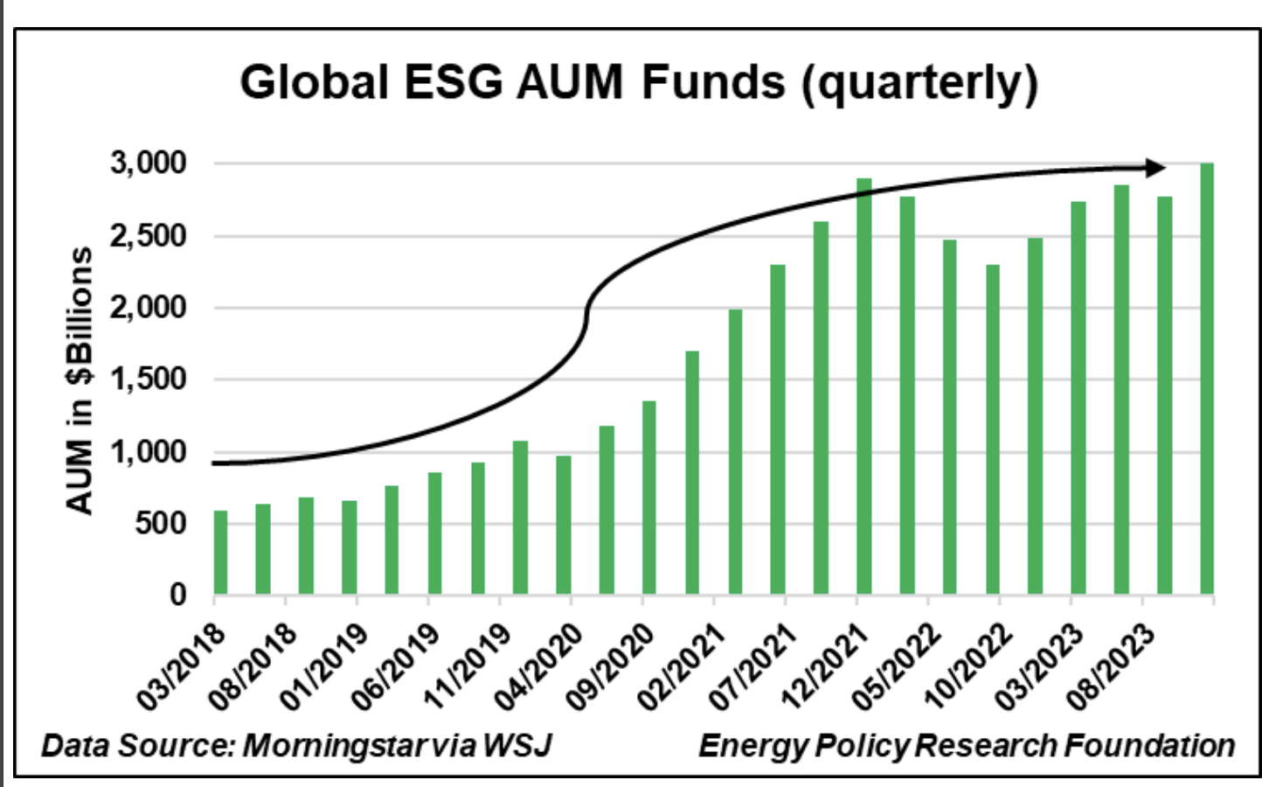
Introduction
The Market
Market Growth: The global ESG investment fund market attracted $29 billion in Q1 2023, representing 30% of total assets worldwide.
China's Leadership: China is the largest sustainable fund market in Asia, highlighting the importance of ESG investing for informed decision-making.

Slide 4
Introduction
What is ESG
ESG stands for Environmental, Social, and Governance.
ESG performance is quantified by external third-party ratings, through analysis of a firm’s annual sustainability report, regulatory disclosures, sustainability initiatives and investments
It’s a way to evaluate how companies operate and their impact on the world around us.
E
S
G

Slide 5
Introduction
What is ESG investing?
Looking at ESG ratings, investors may gauge the company’s risk outlook and possible future opportunities.
ESG investing considers ESG performance in companies to make better investors decisions.
Theoretically long-term returns improve by looking at more resilient and responsible businesses.
E
S
G

Slide 6
Objective
The research question
Resilient and responsible companies have better ESG performance and lower investment risk.
Can we project volatility in stock returns using ESG data in Hong Kong? (ESG investing)
We investigate the correlation between ESG performance and stock price volatility in HK market from 2020 onwards.

Slide 7
Objectives
Our focus and approach
We investigate the correlation between ESG performance and stock price volatility in HK market from 2020 onwards.
Focus:
Hong Kong market: Unique insights, more relevant to us.
Investment risk: Price volatility is a direct measure of investment risk.
Instead of stock price return which reflects short-term returns
2020-2023 : New regulatory change from HKEX, mandates ESG disclosure.
Approach: Quantitative study with qualitative insights from journal reviews and relevant studies.
Deeper insights of ESG impact on investment risk management

Slide 8
Hypothesis and Methodology:
Objective 1: Observe changes in ESG performance 2020-2023
Enhanced regulation has improved ESG performance in Hong Kong.
Objective 2: Investigate companies with higher ESG performance and relationship with stock volatility.
The ESG Risk Score (independent variable) is positively correlated with share price volatility (dependent variable).

Slide 9

Constructing the relationship
Multi linear regression equation
Y is the dependent variable, share price volatility,
X1 is the independent variable, ESG risk score,
X2,3,4 are the control variables (profitability, leverage and company size),
α is the intercept
β 1,2,3,4 are the respective calculated coefficients for each independent variable.
Statistical regression analysis will be used to determine correlations, with control variables including profitability, financial leverage, and company size.

Slide 10
Data Collection:
Price Volatility (Dependent variable)
Standard deviation of daily change in share price (Yfinance)
ESG risk score (Independent variable X1)
Morningstar ESG risk score (yfinance)
The higher the score, the riskier or less effective the firm is in managing ESG-related risks.
Leverage, Profitability, Company size (control variable X2,3,4)
Debt to capital, Return on invested capital and number of employees
E
S
G

Slide 11
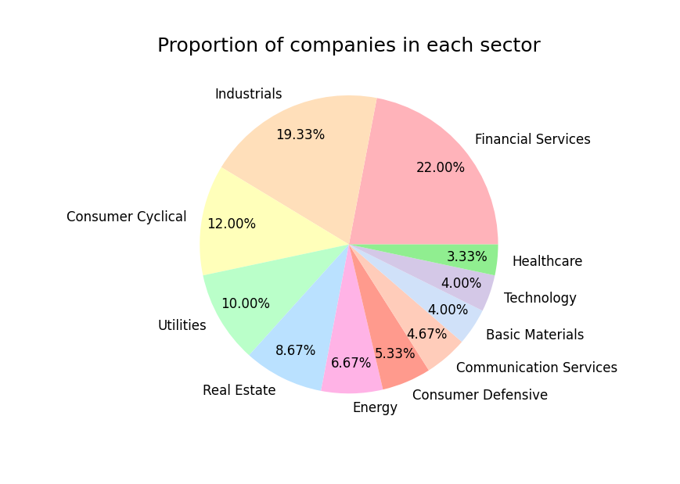

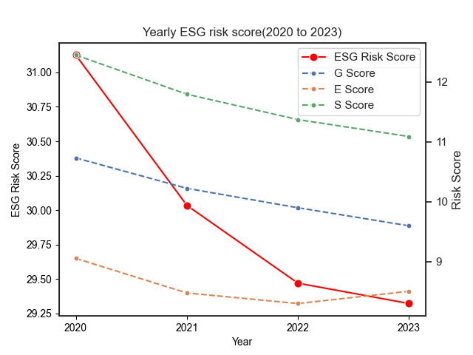
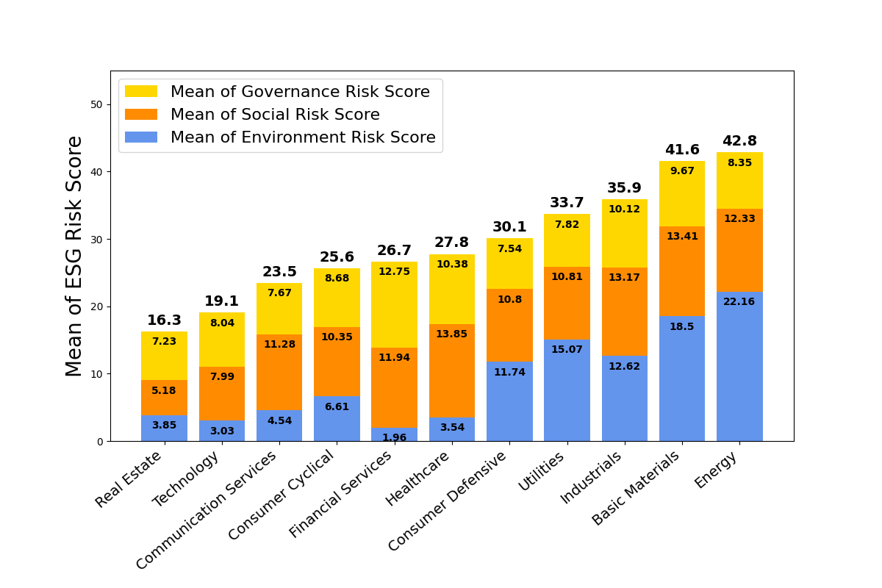
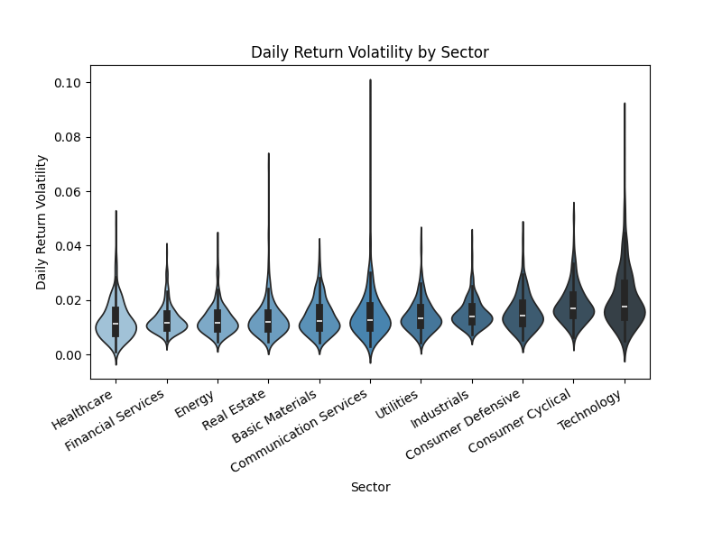
Data Analysis and Discussion:
150 HK LISTED COMPANES
ESG RISK SCORE TREND
YR 2023 ESG RISK SCORE
SHARE PRICE VOLATILITY

Slide 12
Data Analysis and Discussion:

Slide 13
Proportion of companies in each sector:
In terms of number of companies:
Largest Sectors :
Financial Services (22%)
Industrials (19%)
Smallest Sectors :
Healthcare and Technology (<5%)

Slide 14
Stacked Bar Chart on mean of ESG risk score:

Slide 15
Observation 1 :
ESG risk scores higher in non-service sectors
Environment risk scores dominate
Highest Average ESG risk scores
Energy, Basic Materials, Industrial, Utilities, Consumer Defensive
Environment risk components
Resources Extraction or Manufacturing
Stricter regulations on Environmental controls

Slide 16
Observation 1 :
ESG risk scores higher in non-service sectors
Environment risk scores dominate
Sectors with Higher Governance and Social Risk Scores
Financial Services, Healthcare, Industrials
Need to focus more on :
Corporate Governance Practice
Addressing Social issues

Slide 17
Observation 2:New regulations-improved ESG performance

Slide 18
Observation 2:New regulations-improved ESG performance
Mean of ESG Risk Scores over 2020 to 2023
Overall Downward trend
Improvement in ESG Risk Management in HK
Companies adopting sustainable practices
Social remains largest component

Slide 19
Observation 2:New regulations-improved ESG performance
Mean of ESG Risk Scores over 2020 to 2023
Uptick in Environment Score from 2022 to 2023
New regulatory changes in 2020 in Europe & US
Strengthen scrutiny of ESG practice
More transparent reporting to attract Capital Investment

Slide 20
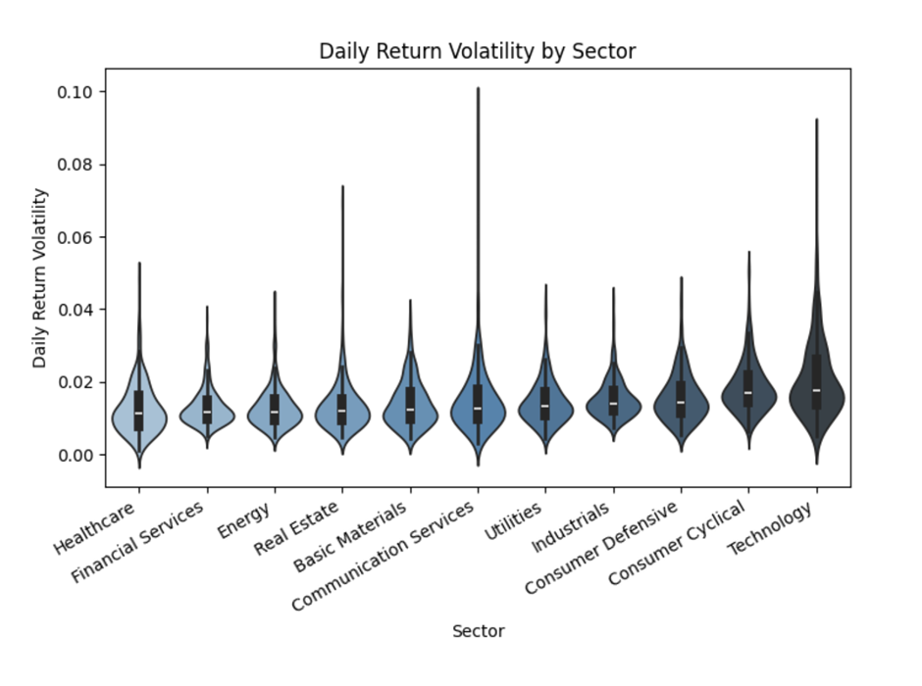
Violin Plot on Sector Price Volatility 2023 :

Slide 21
Observation 2 :Share price Volatility by Sector 2023
Similar levels of volatility for most Sectors
Sectors with relatively low volatility :
Healthcare and Financial Services
Consistent consumer demand or earnings
Sectors with higher volatility :
Technology and Consumer Cyclical
Sensitive to Market trends, Innovation, Consumer demand

Slide 22
Observation 2 :Share price Volatility by Sector 2023
Sectors with higher volatility spikes :
Technology, Communication Services, Real Estate
Significant fluctuation above Sector average
Unforeseen changes in :
Earnings,
Merger and Acquisitions,
New unique challenges

Slide 23
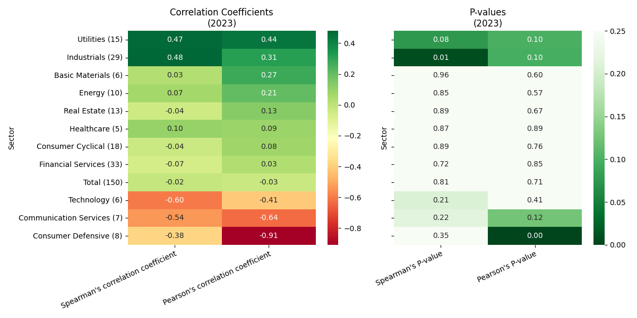
Simple regression analysis between ESG risk score and volatility:
No relationship observed for total market, overall market no clear trend except Utilities and Consumer Defensive.

Slide 24
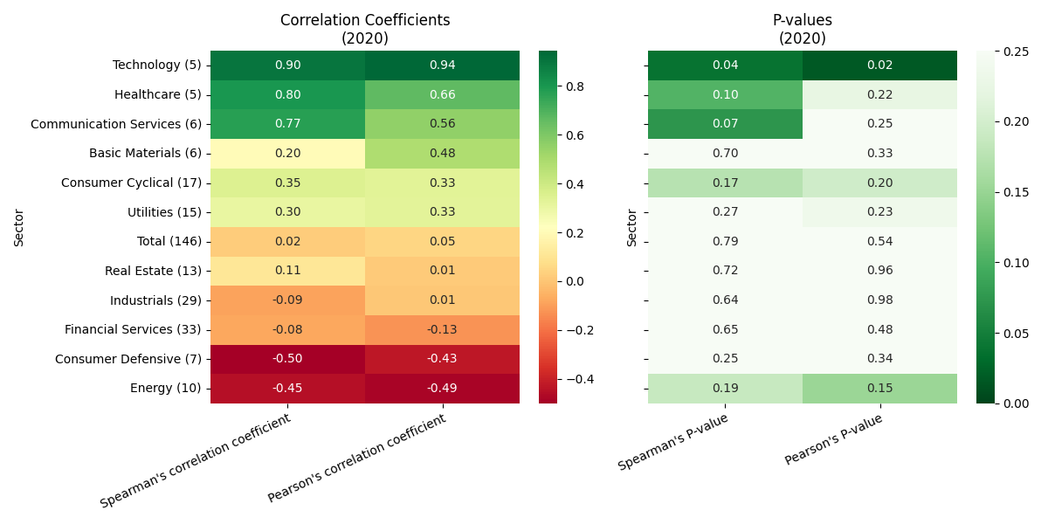
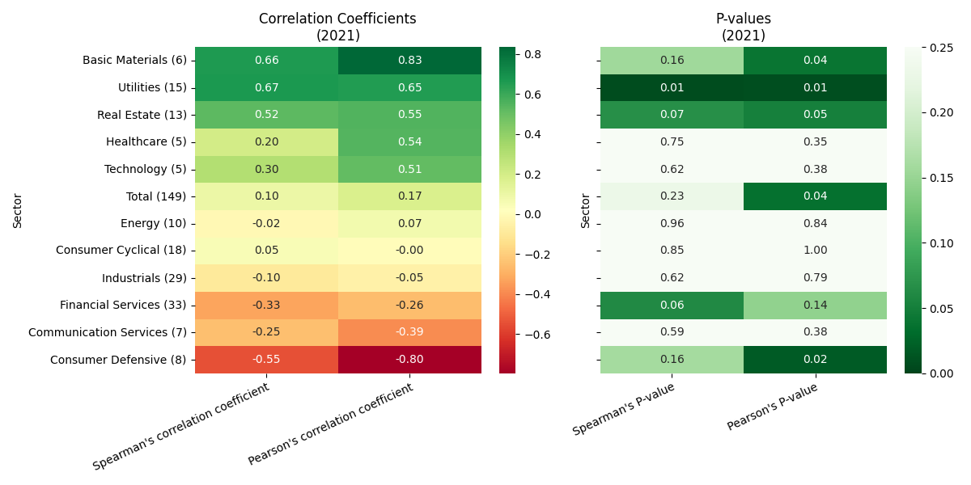
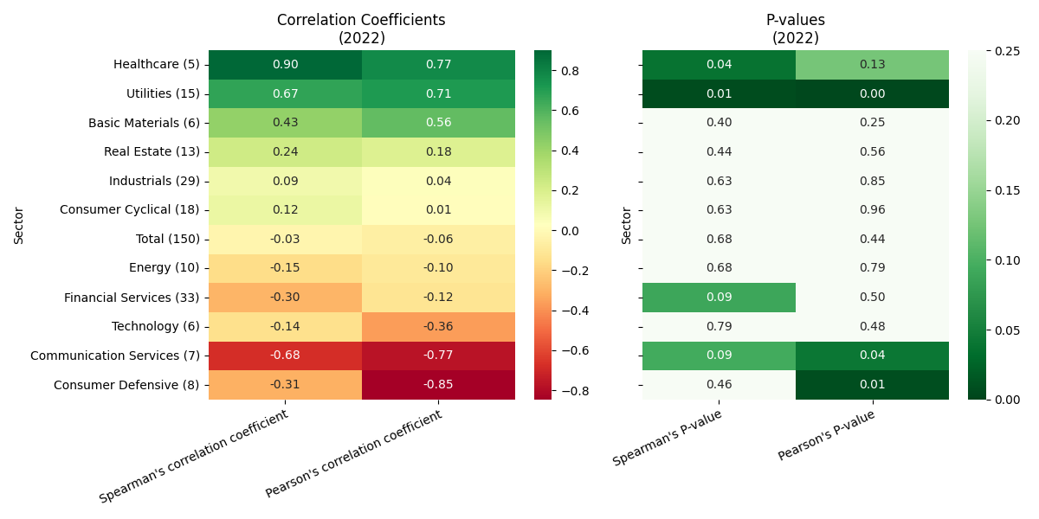
Simple regression analysis between ESG risk score and volatility:
Utilities : consistent positive linear relationship
Consumer Defensive : consistent negative linear relationship
P-values < 0.05
Linear relationship not due to random chance

Slide 25
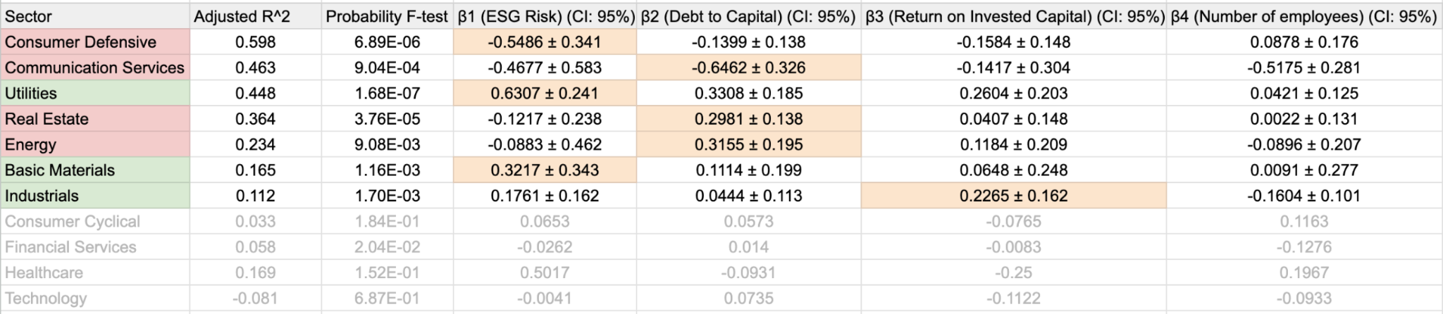
Observation 3: ESG risk score can be a significant predictor variable for volatility in some sectors.
Seven sectors with statistically significant results in our multilinear regression model
F-test passed (Reject H0: β1 = β2 = β3 = β4 =0)
In most service industries : ESG risk score is not a good predictor, they also have inherit lower esg risk score.

Slide 26
Observation 3: ESG risk score can be a significant predictor variable for volatility in some sectors.
The ESG Risk Score (X1) is positively correlated with share price volatility (Y).
Mixed insight : 3 sector show positive correlation , 4 sector show negative.
Most ESG correlation coefficient β1 in sectors are large and relevant to the sectors (compare with number of employees)
Focus on Consumer Defensive, Communication Service and Utilities for further analysis. (R2~50%) (Talk about Debt to Capital in Real Estate New World Development)

Slide 27

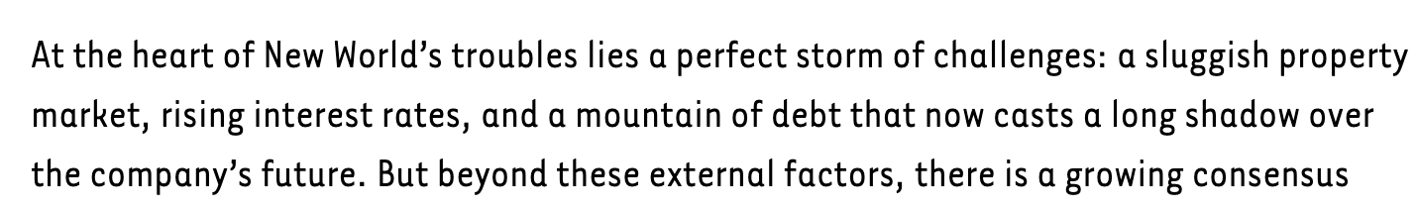
Observation 3: ESG risk score can be a significant predictor variable for volatility in some sectors.
Debt to Capital in Real Estate Sector
New World Development Case Study

Slide 28
Observation 3: ESG risk score can be a significant predictor variable for volatility in some sectors.
The ESG Risk Score (X1) is positively correlated with share price volatility (Y).
Utilities sector showed a consistent positive correlation in agreement with our initial hypothesis in both models.
Most influential independent variable (largest β) amongst variables.
High ESG risk due to the nature of its business operation.
Higher ESG risk = Higher volatility observed.
Same observation in S&P 500 market in Utilities sector.

Slide 29
Observation 3: ESG risk score can be a significant predictor variable for volatility in some sectors.
The ESG Risk Score (X1) is positively correlated with share price volatility (Y).
Financial Improvement in Utilities sector could focus on ESG performance.
Studies shown sustainability initiatives improve corporate financial performance.
Enhanced risk management, increased innovation, greater investor confidence.
High ESG risk score can improve which may lead to increase stability in price volatility.

Slide 30
Observation 3: ESG risk score can be a significant predictor variable for volatility in some sectors.
The ESG Risk Score (X1) is positively correlated with share price volatility (Y).
Consumer Defensive and Communication showed a negative correlation in disagreement with our initial hypothesis in both models.
Influential β values (not close to 0)
Higher ESG risk = Lower volatility observed.
Lower ESG risk = High volatility observed

Slide 31
Observation 3: ESG risk score can be a significant predictor variable for volatility in some sectors.
Consumer Defensive and Communication showed a negative correlation in disagreement with our initial hypothesis in both models.
Possible explanation :
Risk Aversion in High ESG risk score sector
Less trading volume, higher volatility
High ESG risk = Low Volatility
2. Market inefficiency for ESG scores HK Investors adjust for ESG related news slowly
High ESG risk = Low Volatility

Slide 32
Observation 3: ESG risk score can be a significant predictor variable for volatility in some sectors.
Consumer Defensive and Communication showed a negative correlation in disagreement with our initial hypothesis in both models.
Possible explanation :
3. ESG disclosure metrics could not effectively predict financial performance.
Study found a similar negative regression relationship to our study, ESG disclosure, when considered in isolation, was associated with a decrease in firm value.
Better to consider specific performance metrics (Greenhouse Gas emissions)
look at company sustainability action in reports, investments and initiatives.

Slide 33
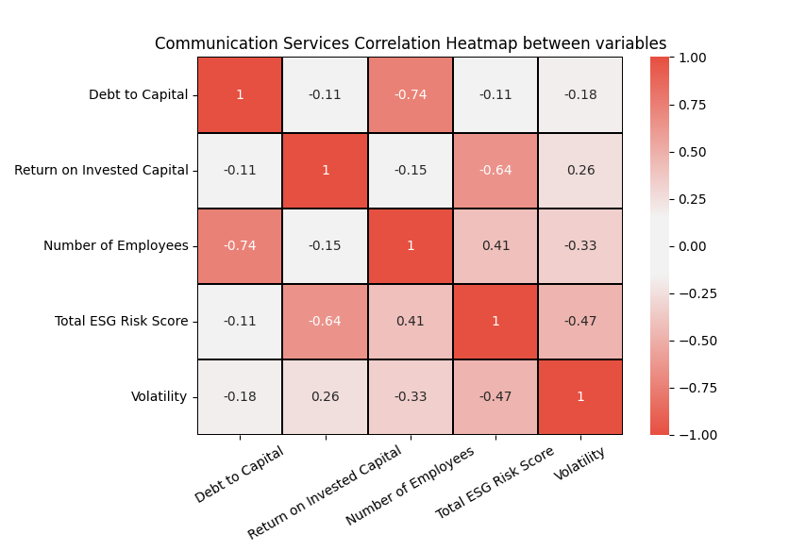
Observation 3: ESG risk score can be a significant predictor variable for volatility in some sectors.
Consumer Defensive and Communication showed a negative correlation in disagreement with our initial hypothesis in both models.
Possible explanation :
4. Multicollinearity (large error):
Many negative correlation between variables
Hard to isolate effect of ESG risk directly
ESG risk correlation between variables (|r|>0.40)
Brings the accuracy of this value in question.

Slide 34
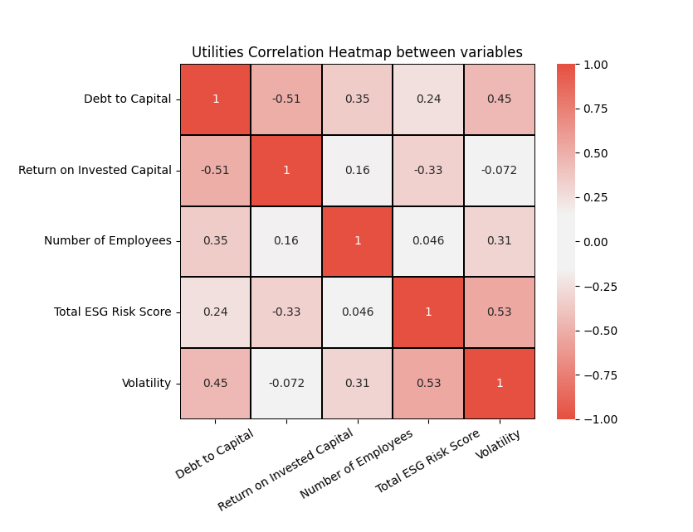
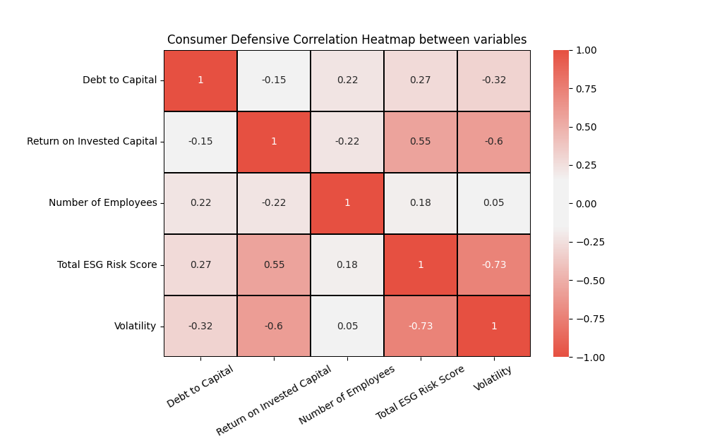
Multicollinearity effect smaller in Utilities and Consumer defensive, leading lower error values and higher statistical significance.

Slide 35
Limitations
Data Availability: The reliance on a single set of ESG performance measurements introduce biases.
It would be more effective to aggregate data from multiple rating agencies to obtain a comprehensive view of ESG performance.
However, this approach may be hindered by the lack of coverage for all listed firms on the exchange.
Temporal Scope: The analysis is confined to data from 2020 to 2023, which may not capture long-term trends or the full impact of evolving ESG practices and regulations.
One could conduct longitudinal studies on a particular sector to provide deeper insights into the long-term effects of ESG integration on financial performance and volatility, considering evolving market conditions.

Slide 36
Limitations
Sector Representation: Certain sectors, such as Healthcare and Technology, have limited representation in our dataset.
Skewing results and limiting the generalizability of findings.
Multicollinearity: We observe correlation between our independent variables.
This makes it difficult to determine the individual effect of each independent variable, leading to less reliable statistical inferences.
It makes it challenging to find which variables are truly significant predictors of the dependent variable (volatility).
Further research could include other control variables and remove ones with high correlation, or combine highly correlated variables using principal component analysis as a composite variable.

Slide 37
Limitations
Control Variables: Control variables such as profitability, leverage, and company size were included, other factors influencing volatility, such as macroeconomic conditions or investor sentiment, were not accounted for in this analysis.
Although adding additional control variables would lead to a more accurate model, this risks overfitting the model and losing a sense of generalisability to compare to other datasets as it becomes too tailored for the HK market.

Slide 38
Conclusion
Resilient and responsible companies have better ESG performance and lower investment risk.
Can we project volatility in stock returns using ESG data in Hong Kong? (ESG investing)
We investigated the correlation between ESG performance and stock price volatility in HK market from 2020 onwards.

Slide 39
Conclusion
Observation 1 :
ESG risk scores higher in non-service sectors, Environment risk scores dominate.
Observation 2:
New regulations-improved ESG performance
Positive trend in sustainable practices
Improve ESG performance through further disclosure requirement.
(more transparency, and stricter ESG performance requirement)
Attract long-term capital investment, and increase firm value
E
S
G

Slide 40
Conclusion
Observation 3:
ESG risk score is a significant predictor of share price volatility of the Consumer Defensive, Communication Services and Utilities sectors.
Mixed results in different sectors. (positive and negative correlation seen)
Consider sector-specific dynamics when integrating ESG factors into their investment strategies.
Better to use ESG scores as a guideline, examine firm’s sustainability action and investments in their sustainability reports
Better understand firm’s risk and future opportunities.
E
S
G

